Slide 1
Introduction to Energy Systems
Module 1 Part 2
Basic Tools for Analysis of Energy Systems
Prepared by: Prof. Amin Ghobeity
Please do not distribute without permission

Slide 2
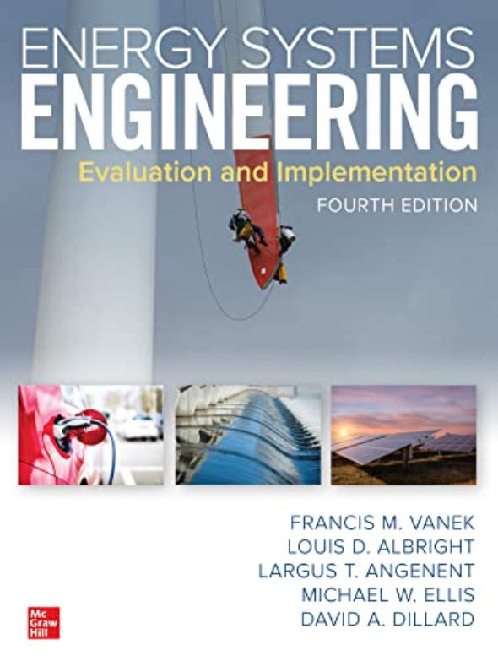
References
Instructor Notes
Energy Systems Engineering: Evaluation and Implementation, 4th Ed.
McGraw-Hill, New York, 2016
Chapter 2 & 3

Slide 3
Outline
Energy Consumption Growth Model
Economics Analysis of Energy Systems

Slide 4
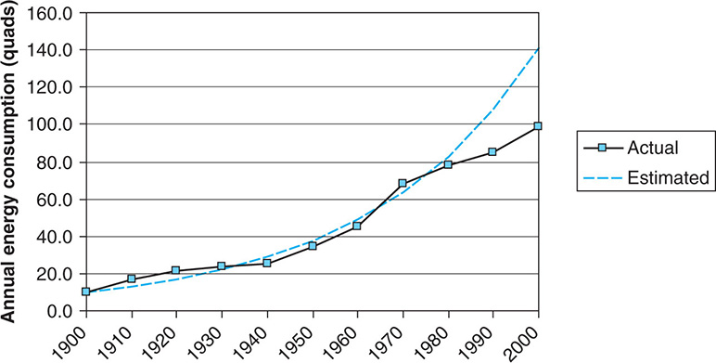
Energy Consumption Growth Models - Exponential
Exponential growth model is a good model for short-term prediction of an early adoption of new energy systems

Slide 5
Energy Consumption Growth Models – Logistics
Logistics growth model: the growth rate slows as it approaches some absolute ceiling in terms of magnitude
Here t is the value of time in appropriate units (e.g., years, months),
f(t) is the fraction of the population that has converted to the new technology at time t,
F is the maximum fraction or market penetration that is expected (i.e., F = 100% if the entire market is eventually expected to convert, or less if some fraction is expected to remain unconverted),
c1 and c2 are parameters used to shape the function so that it fits the historically observed rate of penetration.

Slide 6



Example – Adoption of EVs
Vehicle production in a country amounts to 1 million vehicles per year, which does not change over time since it depends on typical demand. Starting in the year 2013, manufacturers begin to produce electric vehicles too. Compute future penetration of electric vehicle using the logistics growth model, assuming that ultimately 100% of all vehicles produced are EVs. Suppose we treat 2013 as year 0, and that 5000 EVs are in the market. In 2014, the number rises to 20,000 EVs. How many electric vehicles are produced in 2016?
c₁ = –5.29
c₂ = 1.40
Since f(3) = 0.252, the prediction is that 0.252(1 × 10⁶) = 252,000 EVs will be made in 2016

Slide 7
Part 2
Economic Analysis

Slide 8
Economic Analysis
Energy systems analysis involves comprehensive treatment of various cost and revenue components
Various parameters are important. Namely, initial capital cost, interest, net present vale (NPV), capital recovery factor (CRF), annuity, term of project, annual capital cost (ACC)
Economic analysis influences decisions on energy projects. For instance, Electric Power Research Institute (EPRI) recommends, as a general rule, that a CRF < 12% for a power plant to be economically viable (check definition of ACC in the following slides)

Slide 9
Economic Equivalence Allows us to Compare Alternatives on a Common Basis
Each alternative can be reduced to an equivalent basis dependent on
  interest rate,
  amount of money involved, and
  timing of monetary receipts or expenses.
Using these elements, we can “move” cash flows so that we can compare them at a particular point in time (typically to present). Usually equivalent present value, i.e., the net present value (NPV) is considered.
Notes:
Slide 2 is list of textbook LO numbers and statements

Slide 10
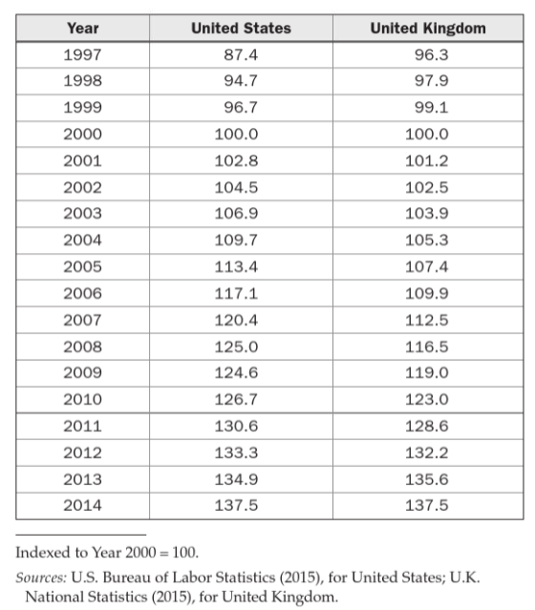
Value of Money and Types of Economic Analysis
Value of money declines with time
Simple Payback Cash Flow Analysis ignores the change in value of money
Discounted Cash Flow Analysis takes into account the change in value of money

Slide 11
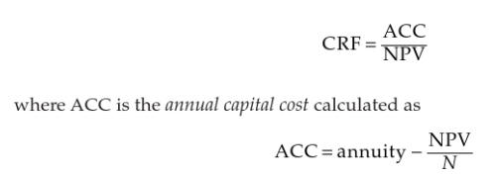
Simple Payback
Simple payback is reasonable for small projects over short term. NPV and CRF are considered in such analysis
Net present value (NPV) is calculated taking into account initial cost, annuities (+/-), and salvage value
NPV>0 indicates a financially viable project
Capital recovery factor (CRF), as applied to electricity generation industry, is a measure of relationship between cashflow and investment cost.
High CRF indicates a high annual cost compared to net value of the project. CRF should typically be below 12%
IMPORTANT:
NPV and CRF are typically calculated based on a discounted cash flow analysis

Slide 12
Discounted Cash Flow Analysis
Takes into account time-value of money. This requires us to define a few terms and tools to find economic equivalences
Notation used in formulas for compound interest calculations.
  i = effective interest rate per interest period
  N = number of compounding (interest) periods
  P = present sum of money; equivalent value of one or more cash flows at a reference point in time; the present
  F = future sum of money; equivalent value of one or more cash flows at a reference point in time; the future
  A = end-of-period cash flows in a uniform series continuing for a certain number of periods N, starting at the end of the first period and continuing through the last
  S = Salvage value: a one-time positive cash flow at the end of a project from sale of assets at the end of project (e.g. selling used gas turbines)
Notes:
Slide 2 is list of textbook LO numbers and statements

Slide 13
Minimum Attractive Rate of Return
Inflation reduces future value of money
MARR is the minimum investment interest rate required for a project to make the project financially attractive.
MARR is not less than expected rate of inflation.
  If MARR is unknown for a project, then expected inflation rate is used.
  In our analysis, MARR and i, interest rate, are treated similarly, meaning that we are dealing with either MARR (expected return on energy project investment) or an interest rate for borrowed money to pay capital cost.
Note that a project may be considered financially viable through a simple payback analysis but given a possible MARR not viable through a discounted cash flow analysis.

Slide 14
Compound Interest Formulas
Using the standard notation, we find that a present amount, P, can grow into a future amount, F, in N time periods at interest rate i according to the formula below.
In a similar way we can find P given F by
P given F “brings” future expense/revenue F to the present and allows us to do an NPV calculation (for example)
Notes:
Slide 2 is list of textbook LO numbers and statements

Slide 15
It is Common to Use Standard Notation for Interest Factors
This is also known as the single payment compound amount factor. The term on the right is read “F given P at i% interest per period for N interest periods.”
is called the single payment present worth factor.

Slide 16
We Can Use These to Find Economically Equivalent Values at Different Points in Time
$2,500 at time zero (i.e., present) is equivalent to how much after six years if the interest rate is 8% per year?
$3,000 at the end of year seven is equivalent to how much today (time zero) if the inflation rate is 6% per year?
Note that inflation rate, interest rate, and MARR are all treated similarly. We will add inflation and interest rate if both are known.
Notes:
Slide 2 is list of textbook LO numbers and statements

Slide 17
There are Interest Factors for a Series of End-of-Period Cash Flows
How much will you have in 40 years if you save $3,000 each year and your account earns 8% interest each year?
Notes:
Slide 2 is list of textbook LO numbers and statements

Slide 18
Finding A When Given F
How much would you need to set aside each year for 25 years, at 10% interest, to have accumulated $1,000,000 at the end of the 25 years?
Notes:
Slide 2 is list of textbook LO numbers and statements

Slide 19
Finding the Present Amount From a Uniform Series of End-of-Period Cash Flows
How much would is needed today to provide an annual amount of $50,000 each year for 20 years, at 9% interest each year?
Notes:
Slide 2 is list of textbook LO numbers and statements

Slide 20
Finding A when given P
If you had $500,000 today in an investment account earning 10% each year, how much could you collect as interest each year for 25 years?
Notes:
Slide 2 is list of textbook LO numbers and statements

Slide 21
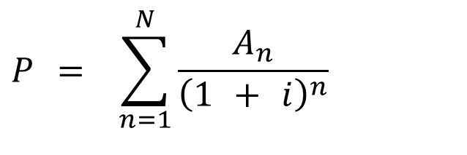
Finding the Present Amount From a Non-uniform Series of End-of-Period Cash Flows
$$P = \sum_{n=1}^{N}{\frac{A_{n}}{{\left(1 + i\right)}^{n}}}$$
Here $A_{n}$ is the value of the annuity predicted in each year n from 1 to N
Notes:
Slide 2 is list of textbook LO numbers and statements

Slide 22
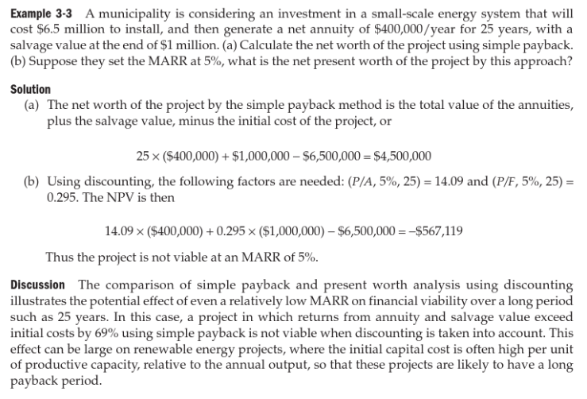
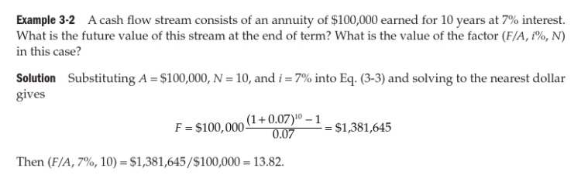
Example – Simple Cash Flow vs. Discounted Cash Flow Analysis

Slide 23
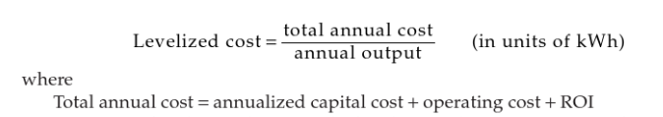
Levelized Cost of Energy (LCOE)
A measure used to compare various electricity production technologies is LCOE
LCOE is often used for benchmarking of various technologies, particularly renewable technologies
Notes:
Slide 2 is list of textbook LO numbers and statements

Slide 24
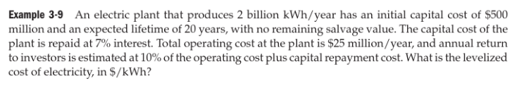
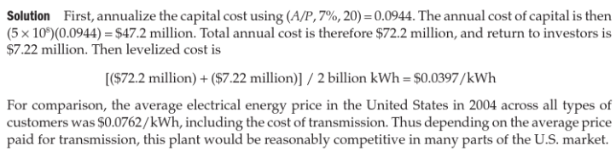
Example – Energy Project and LCOE

Slide 25
Example - Incentives for Renewables
A municipality is considering an investment in a small-scale energy system that will cost $6.5 million to install, and then generate a net annuity of $400,000/year for 25 years, with a salvage value at the end of $1 million. Suppose they set the MARR at 5%, what is the net present worth of the project by this approach?
Recalculate NPV using the following adjustments to reflect government support programs for the project:
a. A rebate of $200/rated kW, if the system is rated at 5000 kW.
b. An operating credit of $0.025/kWh, if the system produces on average 1.8 million kWh/year.
c. An interest rate buydown such that the MARR for the project is reduced to 3%.

